Slide 1
Welcome to
CluedIn Fundamentals
Building a single customer view from disconnected sources to unified data with CluedIn

Slide 2


What you will learn
01
Perform key operations in CluedIn
02
Work with two real-world data sources:
A CSV file from a CRM system
A database table from an ERP system
In this training you will learn how to:
03
Complete the full master data management lifecycle for each data source

Slide 3









Ingest data
Create
relations
Clean
records
Work with
glossary
Deduplicate
records
Create
hierarchies
Create rules
Stream records

Slide 4

Training goal:
CRM and ERP systems both store customer data, but the details are often inconsistent
Get a unified view of your customer
We'll walk you through unifying CRM and ERP records into one trusted customer profile

Slide 5





Reduced duplication
Smarter decisions
Cleaner campaigns, better segmentation
Single source of truth for analytics
Business
value
Less manual work
Seamless exports
Automated pipelines and quality checks
Easily push clean data to downstream systems

Slide 6
Build a 360-degree customer view using two data sources
Identify and fix data quality issues
Results
Here’s what you’ll achieve by the end of this training
Automate unification and export of customer data
Understand how CluedIn fits into Azure’s data ecosystem

Slide 7
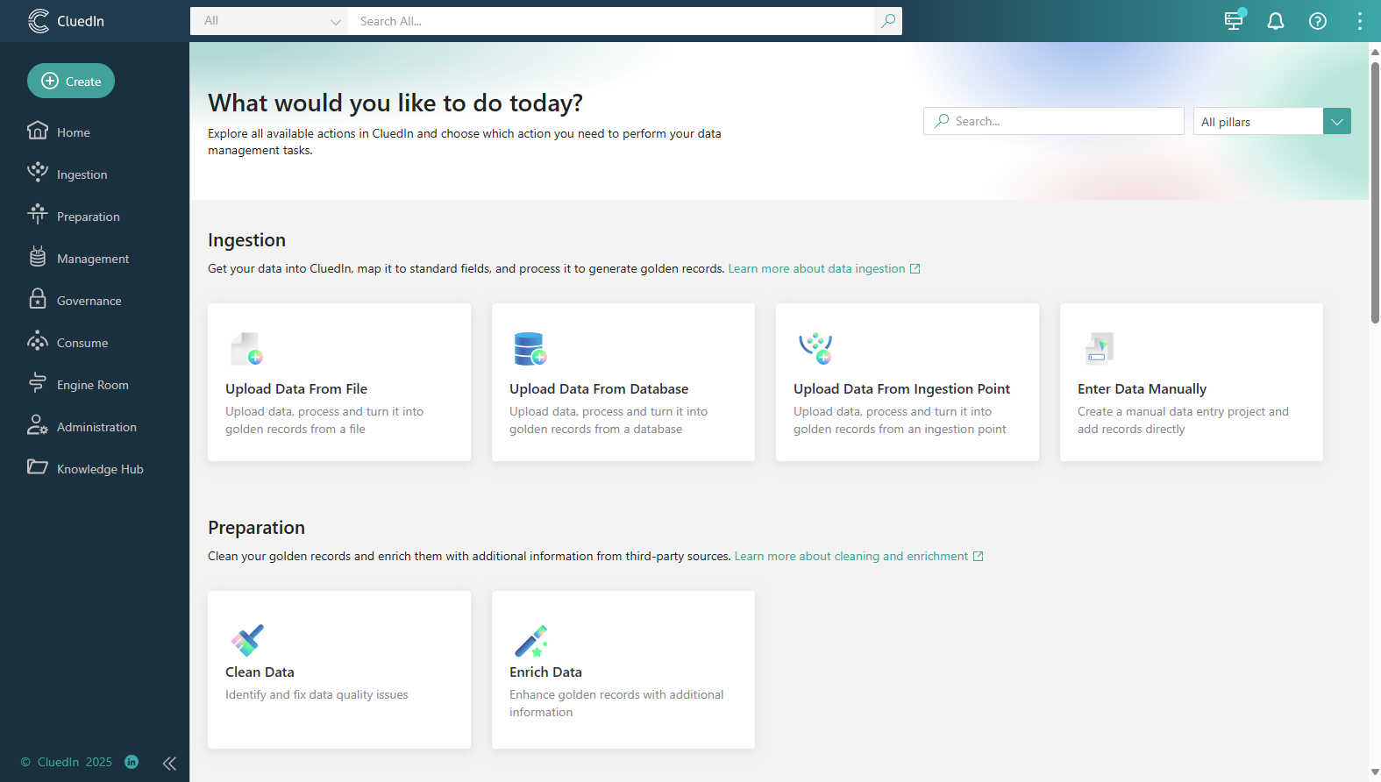
Let’s get started
After the training, you will be able to follow along and experiment with your own data in CluedIn.

